Slide 1

AI Based Virtual Travel Guide
Name: Jacob baby
Roll No: 2214100795
Program: BACHELOR OF COMPUTER APPLICATIONS (BCA)
Semester: VI
Session: NOVEMBER 2024
Date: 12 December 2024

Slide 2



Agenda
Introduction
Technologies used
Data flow diagram(DFD)
Control Flow Diagram (CFD)
Entity Relationship Diagram (ERD)
Project Pages
Future Scope
Conclusion

Slide 3
Introduction to AI Based Virtual Travel Guide
AI Based Virtual Travel Guide:
Designed to help users plan their trips
provides information about various destinations, attractions, hotels, and itineraries.
Aims to enhance the travel planning experience by offering detailed information and personalized itineraries.

Slide 4
Technologies used:
Python
HTML
SQLite
Unit Test Framework
Wikipedia API’s

Slide 5
Data flow diagram(DFD)
User
Admin
Trip Planner App
Trip Planner App
View Destinations
Manage Data
View Attractions
Update Database
Generate Itinerary

Slide 6
Control Flow Diagram (CFD)
User Interface
User Interface
User Interface
Select Continent
Select Destination
Select Destination
Select Country
Fetch Attractions
(Backend API)
Fetch Itinerary
(Backend API)
Fetch Destinations
(Backend API)
Display Destinations
Display Attractions
Display Itinerary

Slide 7
Entity Relationship Diagram (ERD)
Continents
id (PK)
name
image_path
Countries
id (PK)
name
continent_id (FK)
image_path
Destinations
id (PK)
name
country_id (FK)
image_path
Attractions
id (PK)
name
description
image_path
destination_id (FK)
Itineraries
id (PK)
day
description
destination_id (FK)

Slide 8
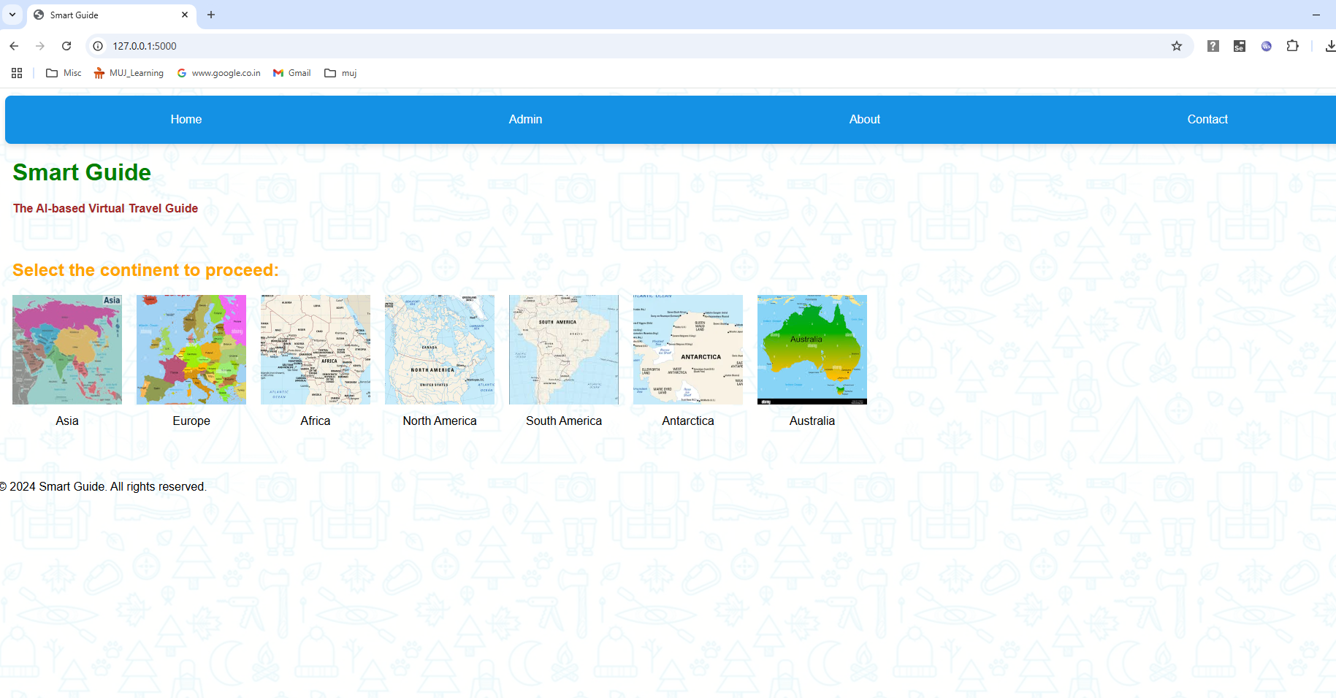
Project Pages: Home Page

Slide 9
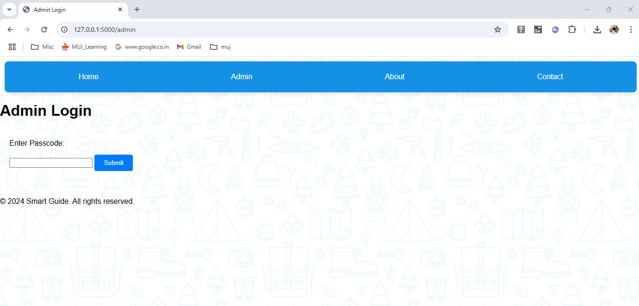
Project Pages: Admin Login Page

Slide 10
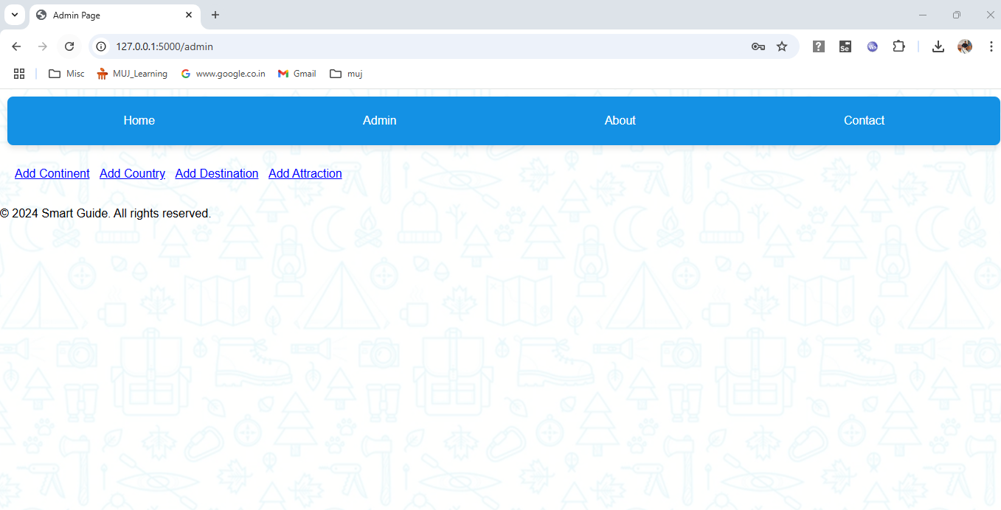
Project Pages: Admin Page

Slide 11
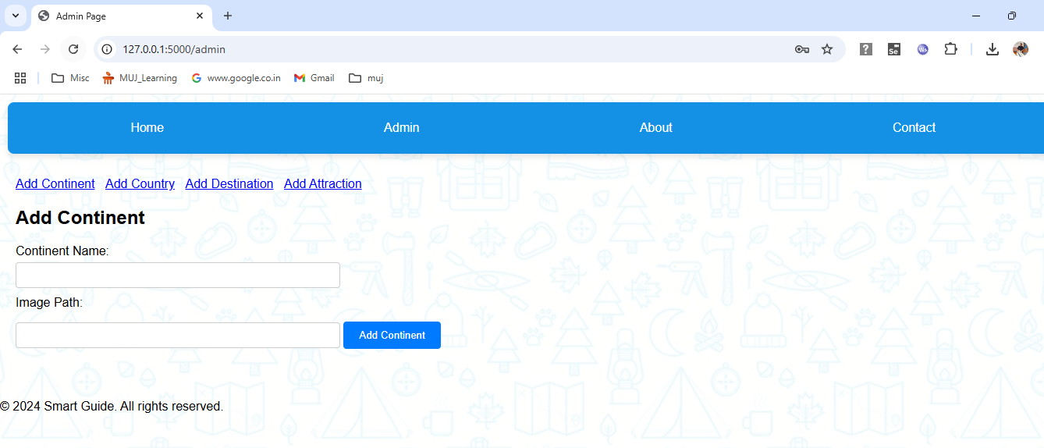
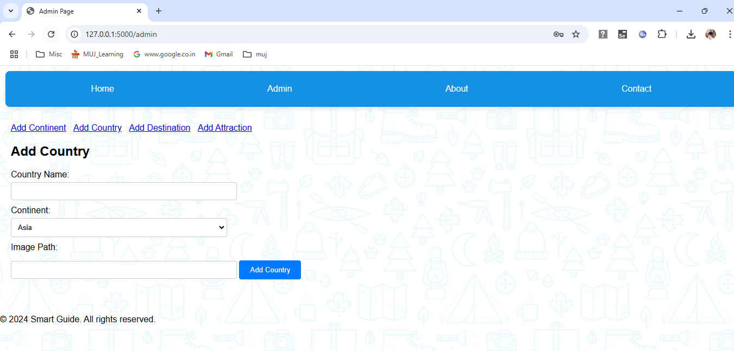
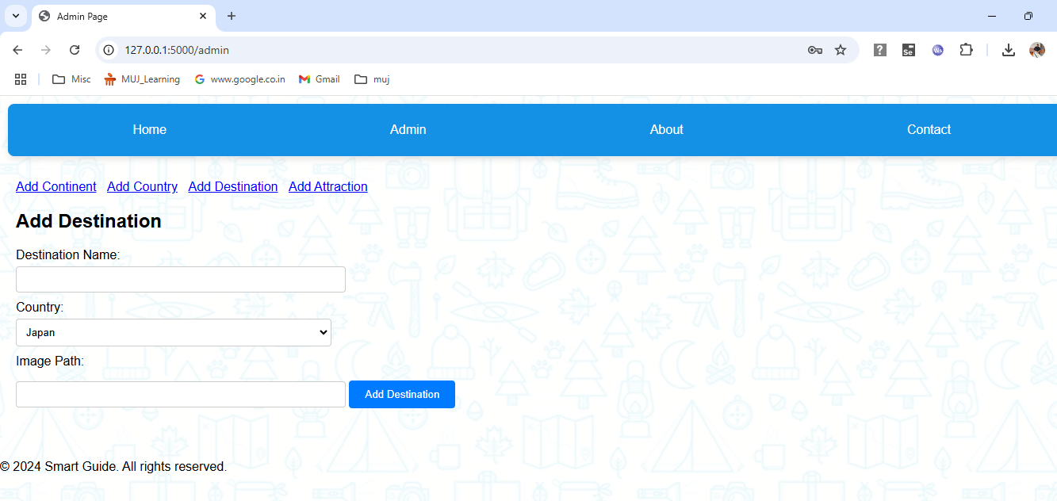
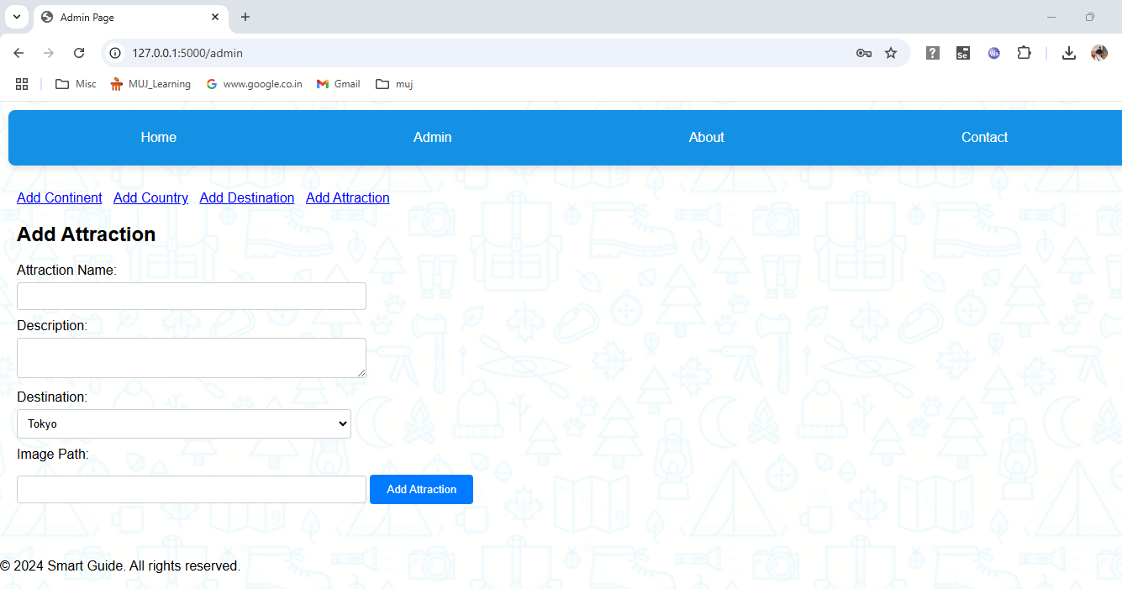
Project Pages: Admin Page - Continued

Slide 12
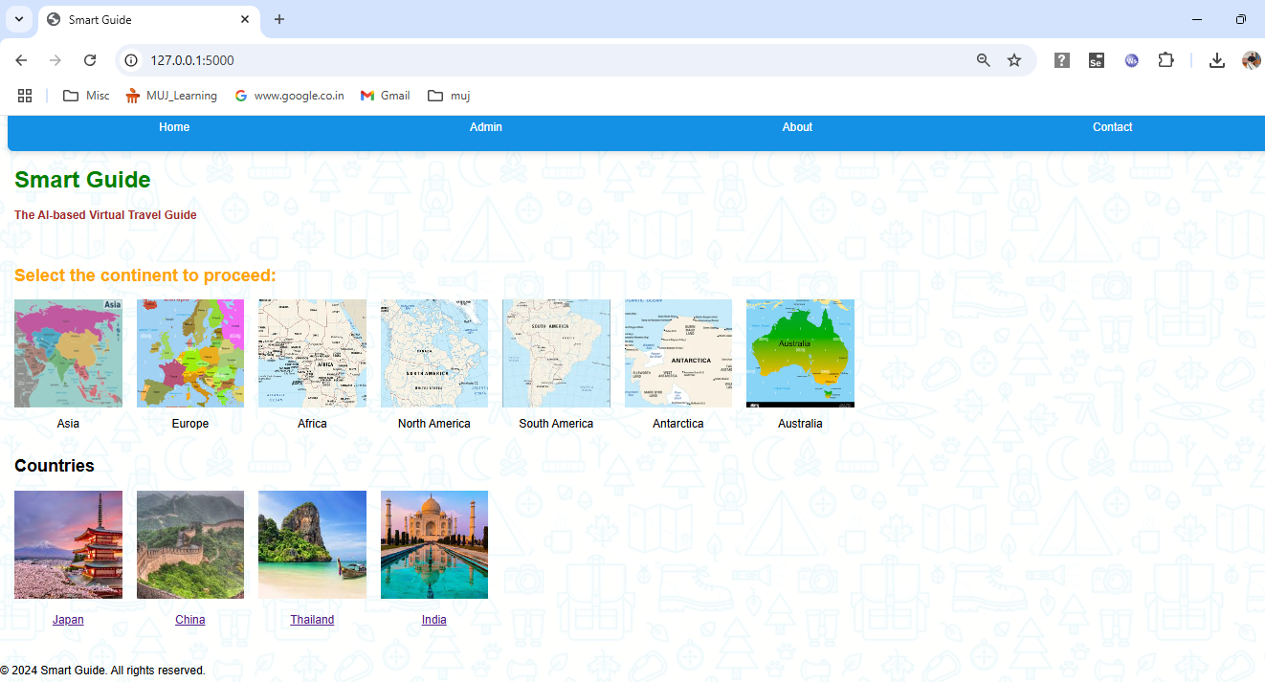
Project Pages: Country Listing Page

Slide 13
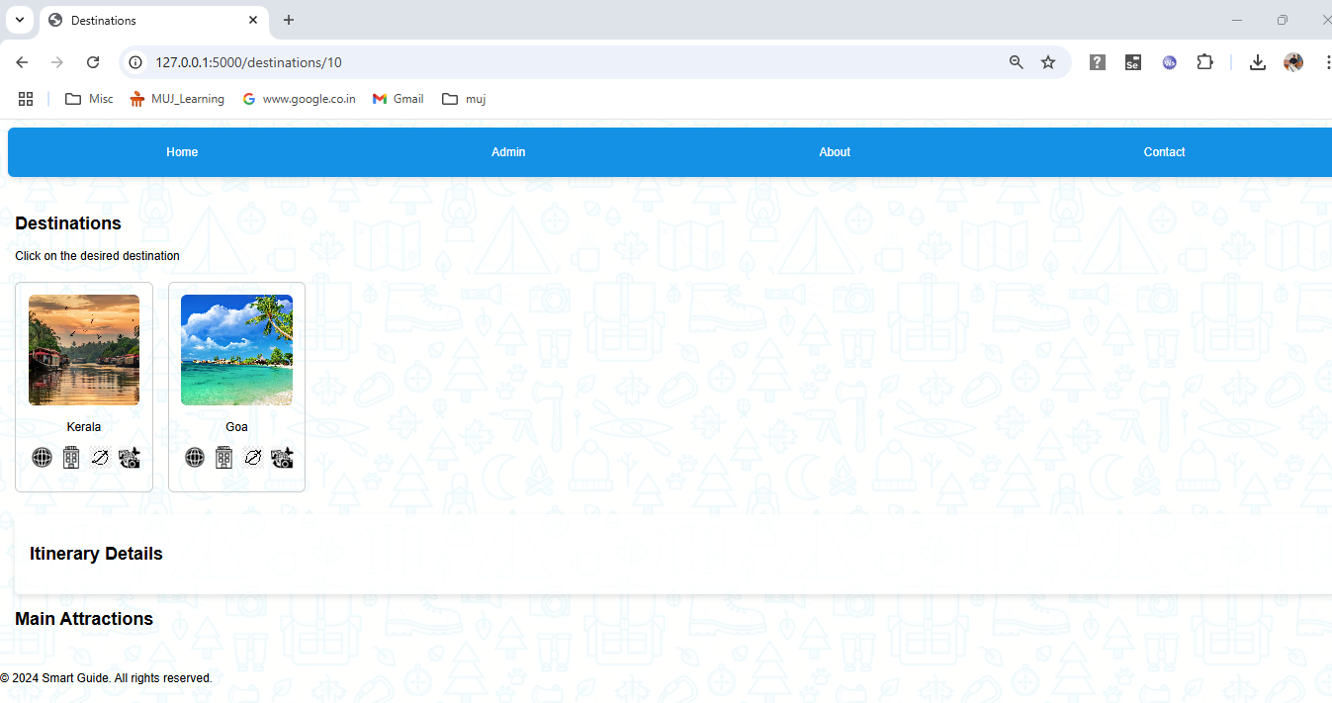
Project Pages: Destinations Page

Slide 14
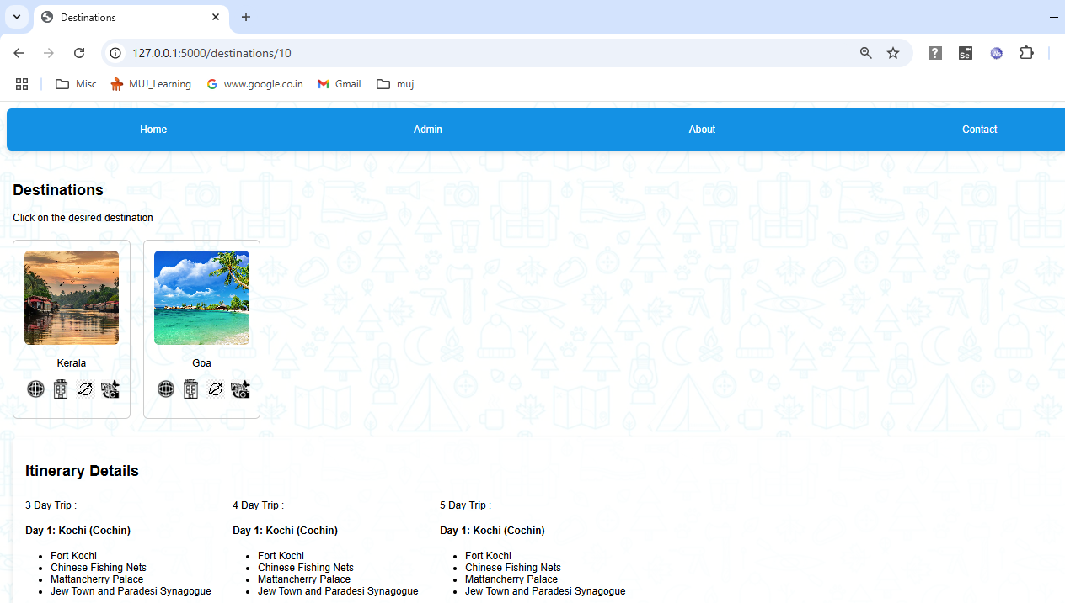
Project Pages: View Attractions and itinerary

Slide 15
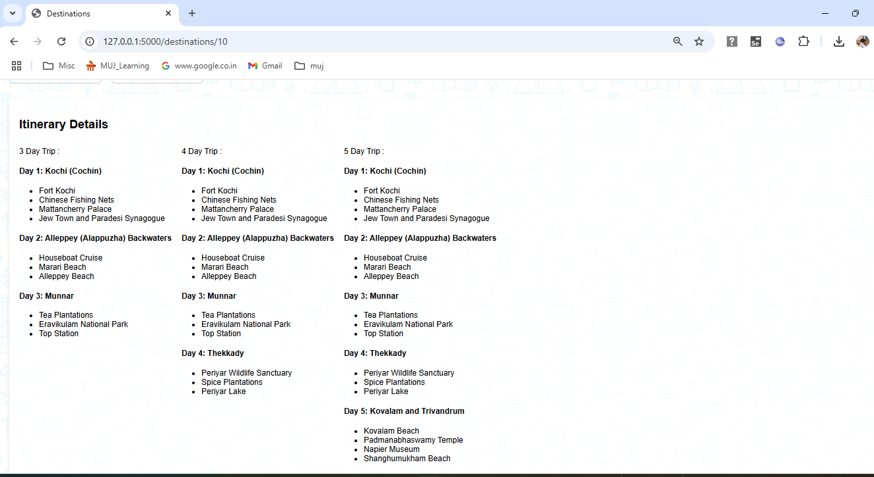
Project Pages: View Attractions and itinerary - Continued

Slide 16
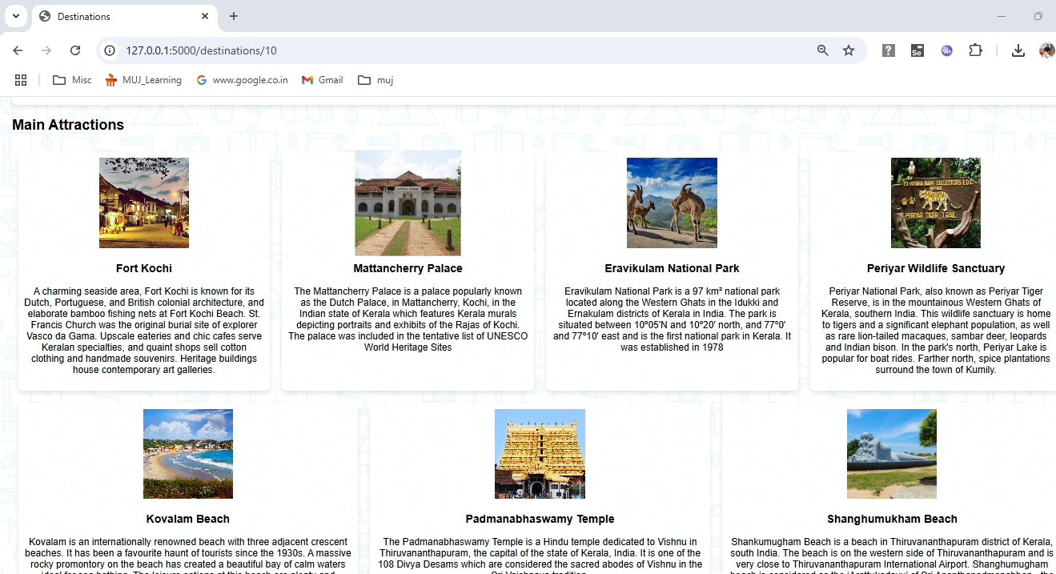
Project Pages: View Attractions and itinerary - Continued

Slide 17
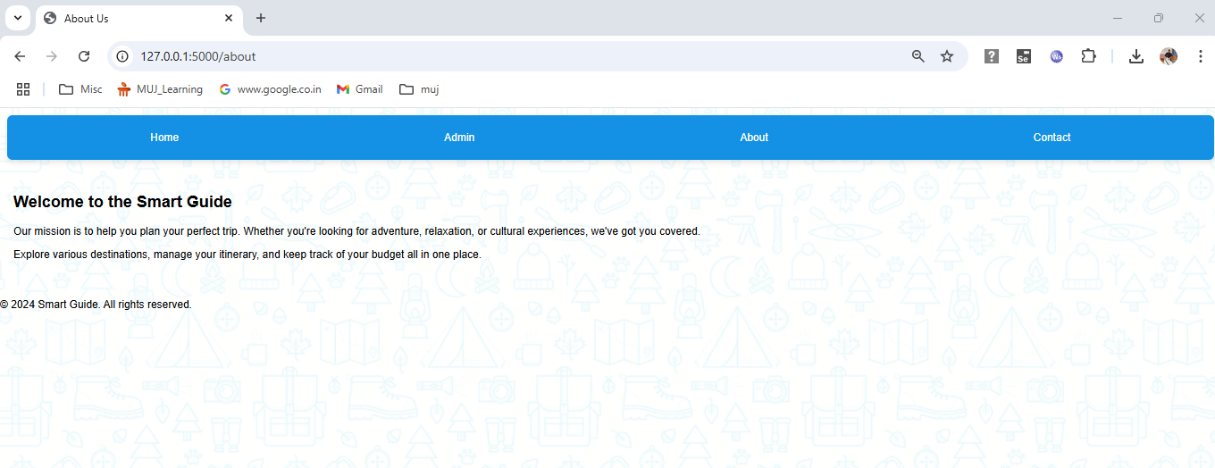
Project Pages: About Page

Slide 18
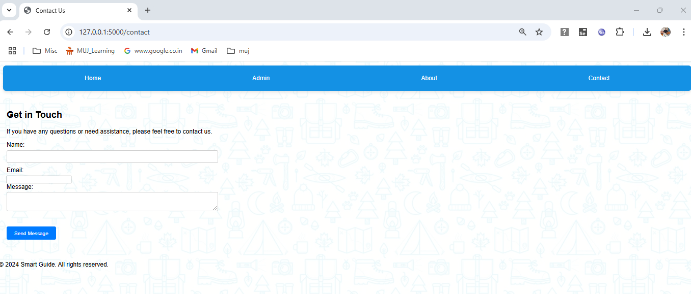
Project Pages: Contact Us Page

Slide 19
Future Scope
User Authentication and Personalization
Advanced Search and Filtering
Reviews and Ratings
Social Sharing and Collaboration
Mobile Application
Integration with Travel Services
Enhanced Itinerary Features
Multilingual Support

Slide 20


Slide 21


